Slide 1
ELECTRONIC MAIL
One of the most popular Internet services is electronic mail (e-mail). The designers of the Internet probably never imagined the popularity of this application program. Its architecture consists of several components that we discuss in this chapter.

Slide 2

Figure 26.6 First scenario in electronic mail

Slide 3

Note
When the sender and the receiver of an e-mail are on the same system,
we need only two user agents.

Slide 4

Figure 26.7 Second scenario in electronic mail

Slide 5
Note
When the sender and the receiver of an e-mail are on different systems, we
need two UAs and a pair of
MTAs (client and server).

Slide 6

Figure 26.8 Third scenario in electronic mail

Slide 7
Note
When the sender is connected to the mail server via a LAN or a WAN,
we need two UAs and two pairs
of MTAs (client and server).

Slide 8

Figure 26.9 Fourth scenario in electronic mail

Slide 9

Figure 26.10 Push versus pull in electronic email

Slide 10
Note
When both sender and receiver are connected to the mail server via
a LAN or a WAN, we need two
UAs, two pairs of MTAs
and a pair of MAAs.
This is the most common situation today.

Slide 11

Figure 26.11 Services of user agent

Slide 12
Note
Some examples of command-driven user agents are mail, pine,
and elm.

Slide 13
Note
Some examples of GUI-based user agents are Eudora, Outlook, and Netscape.

Slide 14

Figure 26.12 Format of an e-mail

Slide 15

Figure 26.13 E-mail address

Slide 16

Figure 26.17 Commands and responses

Slide 17
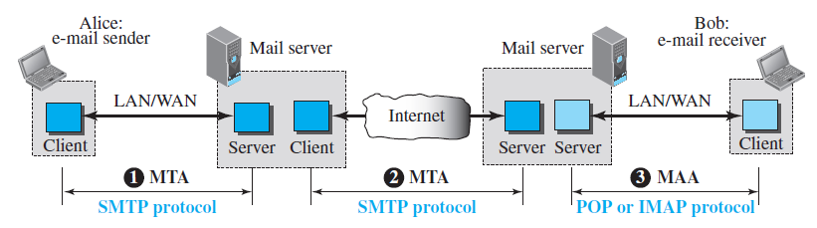
Protocols used in Email
Message Transfer Agent: SMTP

Slide 18

Figure 26.18 Command format

Slide 19
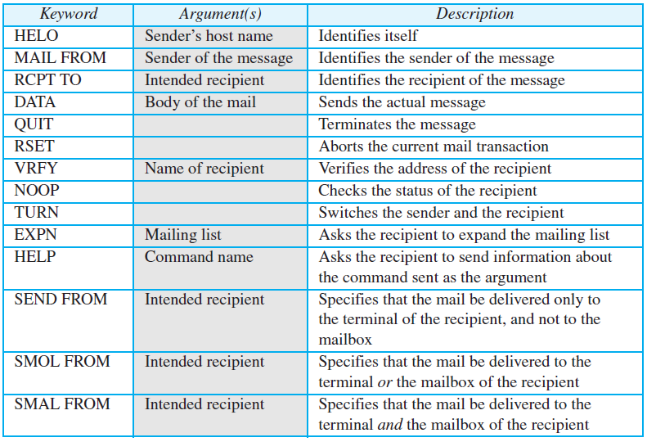
Table 26.7 SMTP Commands

Slide 20
NAME SPACE
To be unambiguous, the names assigned to machines must be carefully selected from a name space with complete control over the binding between the names and IP addresses.

Slide 21
DOMAIN NAME SPACE
To have a hierarchical name space, a domain name space was designed. In this design the names are defined in an inverted-tree structure with the root at the top. The tree can have only 128 levels: level 0 (root) to level 127.

Slide 22

Figure 25.2 Domain name space

Slide 23

Figure 25.3 Domain names and labels

Slide 24
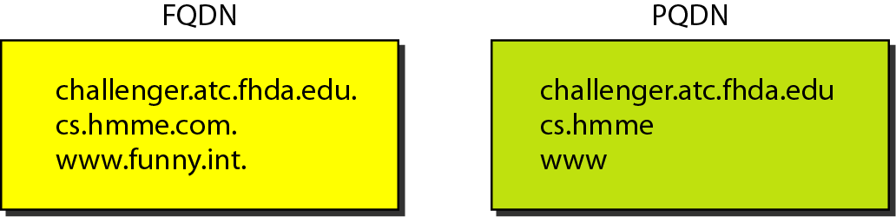
Figure 25.4 FQDN and PQDN

Slide 25

Figure 25.5 Domains

Slide 26
DISTRIBUTION OF NAME SPACE
The information contained in the domain name space must be stored. However, it is very inefficient and also unreliable to have just one computer store such a huge amount of information. In this section, we discuss the distribution of the domain name space.

Slide 27

Hierarchy of name servers

Slide 28

Zones and domains

Slide 29
Note
A primary server loads all information from the disk file; the secondary server
loads all information from
the primary server.
When the secondary downloads
information from the primary, it is called zone transfer.

Slide 30
DNS IN THE INTERNET
DNS is a protocol that can be used in different platforms. In the Internet, the domain name space (tree) is divided into three different sections: generic domains, country domains, and the inverse domain.

Slide 31

DNS IN THE INTERNET

Slide 32

Generic domains

Slide 33

Table 25.1 Generic domain labels

Slide 34

Figure 25.10 Country domains

Slide 35

Figure 25.11 Inverse domain

Slide 36
RESOLUTION
Mapping a name to an address or an address to a name is called name-address resolution.

Slide 37

Figure 25.12 Recursive resolution

Slide 38

Figure 25.13 Iterative resolution

